Slide 1
My Restaurant
Jaroslav Lédl

Slide 2
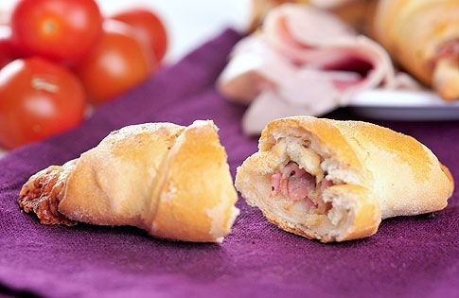
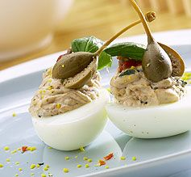
Starter:
1) Croissants made with cherry tomatoes, ham and cheese (Rohlíčky s cherry rajčátky, šunkou a sýrem) 2,5 dollars
2) Pickled cheese (Nakládaný sýr) 3 dollars
3) Eggs stuffed with cream cheese with Basil and nuts (Vejce plněná žervé s bazalkou a ořechy) 3 dollars
4) Canapés with mozzarella and tomatoes (Jednohubky s mozzarellou a rajčátky) 2 dollars
5) Apples stuffed with cream cheese (Jablka plněná krémovým sýrem) 3,5 dollars

Slide 3
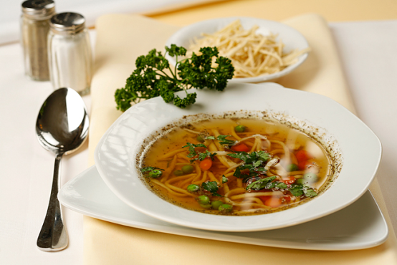
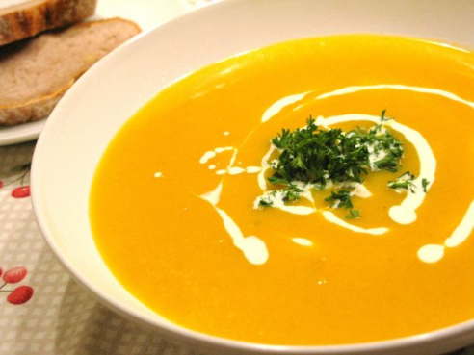
Soups:
1) Beef soup (hovězí polévka) 5 dollars
2) Pumpkin soup (dyňová polévka) 5 dollars
3) Soup of roasted carrots (Polévka z pečené mrkve) 5 dollars
4) Smooth Cauliflower soup with cream (Jemná květáková polévka se smetanou) 6 dollars
5) Broccoli soup with blue cheese (Brokolicová polévka s nivou) 5 dollars

Slide 4
Main dish:
Beef Meals: Beef goulash 5dollars
            Beef with mushrooms 5dollars
            Beef with Garlic 5dollars
            Beef Mushroom rolls 5dollars
            Beef with ginger 5dollars
Pork meals: Pork roast 6dollars
Pork goulash 6dollars
Pork steak 6dollars
Pork in cream 6dollars
Pork roulade 6dollars

Slide 5
Chicken Meals: Chicken roulade 5dollars
            Chicken thighs with honey 5dollars
            Chicken thighs with vegetables 5dollars
            Chicken thighs with mushrooms 5dollars
            Chicken thighs on cabbage 5dollars
Fish meal: Carp with butter 5dollars
Fish fillets 5dollars
Carp on vegetables 5dollars
Carp on blue 5dollars
Calamari 5dollars

Slide 6
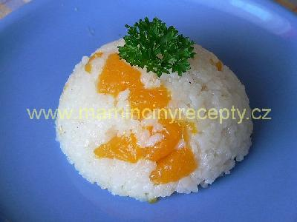
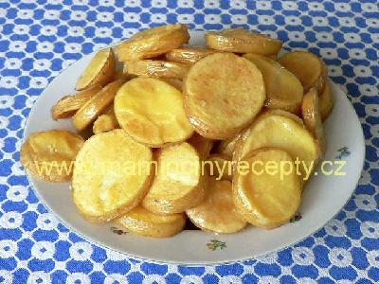
Annex:
Tangerine rice (Mandarinková rýže)
2 dollars
Pasta with breadcrumbs (Těstoviny se strouhankou) 2 dollars
Potato ducats (Bramborové dukátky)
2 dollars
Potato salad with pepper (Bramborový salát s paprikou) 2 dollars
Dumplings (Knedlíky) 2 dollars

Slide 7
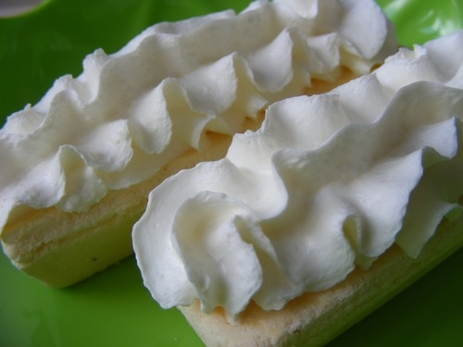
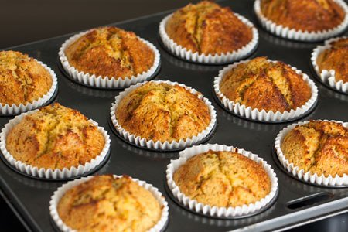
Desserts:
Light fruit dessert (Lehký ovocný moučník)
2 dollars
Pretzels with vanilla filling (Preclíky s vanilkovou náplní) 2,5 dollars
Éclair with whipped cream (Rakvička se šlehačkou) 3 dollars
Banana muffins (Banánové muffiny) 2 dollars
Peanut tube (Arašídové trubičky) 2 dollars

Slide 8
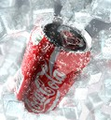
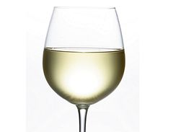
Drinks:
Alcohol drinks: Beer 1 dollars
White wine 1dollars
Red wine 1 dollars
Becher 1 dollars
Fernet 1 dollars
Soft drink: Cola 1 dollars
Orange juice 1 dollars
Apple juice 1 dollars
Coffee 1 dollars
Tea 1 dollars

Slide 9
W: Good morning.
C: Good morning.
W: How can I help you?
C: I would like a menu.
W: Ok, here you are.
C: Thanks. I would like pumpkin soup and rissoto.
W: Please wait
-
C: Ok. How much does it cost ?
W: 12 dollars.
C: Can I pay by credit card?
W: Yes, of course.
C: Thank you. Good bye.
W: Good buy.

Slide 10
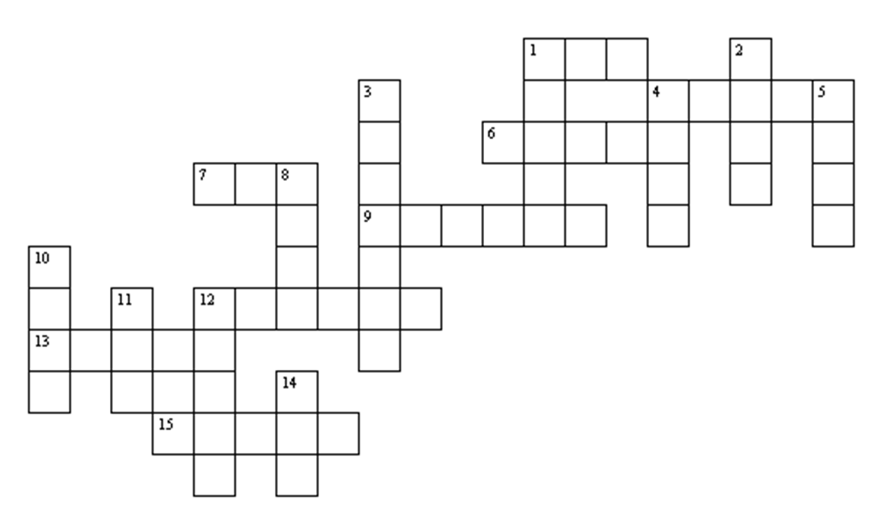
Vertically Horizontally
1 džus 1 marmeláda
2 mléko 4 hranolky
3 kuře 6 pizza
4 koláč 7 šunka
5 polévka 9 káva
8 maso 12 máslo
10 ryba 13 cukr
11 vejce 15 voda
12 chleba
14 čaj

Slide 11
Zdroje:
www.mamincinyrecepty.cz
http://dum.rvp.cz/materialy/anglicke-krizovky-5-jidlo.html
Vytvořil: Jaroslav Lédl

