Slide 1
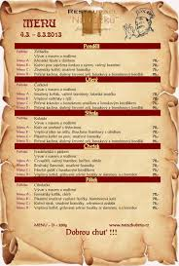
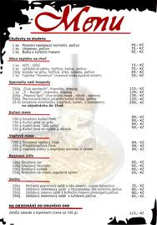
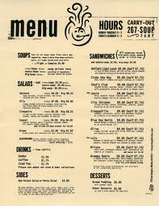
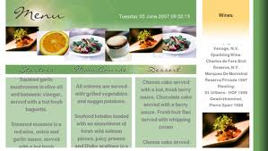
Menu

Slide 2
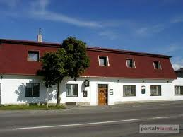
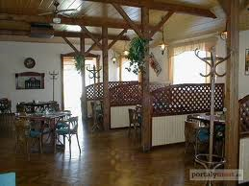
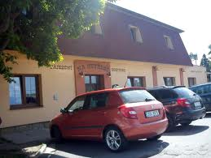
My Restaurant
-This restaurant is called The Needless.
-It was built in 1975.
-There are two floors. In first floor there is the restaurant and in the second pension.
-Outside there is a garden restaurant where you can eat when it's nice weather.
-House owner of this restaurant is Michal Hromádko.

Slide 3
Starter:
Rolls with cherry tomatoes , ham and cheese………. 30CZK
Pickled cheese………. 29CZK
Pies of flaky pastry………. 31CZK
Lorraine cheesecake………. 40CZK
Honey pears with walnuts………. 32CZK
Appetizer:
American cookie………. 15CZK
English sausages baked………. 20CZK
American pizza………. 27CZK
Toasts with the Serbian mixture……….14CZK
English rolls……….18CZK

Slide 4
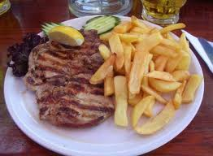
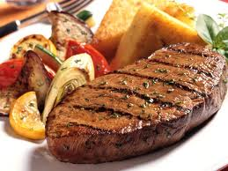
Main meal
Chicken meals:
Chicken steak………. 65CZK
Chicken steak with blue cheese………. 62CZK
Chicken strips with honey………. 98 CZK
Chicken gyros………. 72CZK
Chicken China………. 58CZK
Pork meals:
Pork in dark beer………. 102CZK
Pork steak………. 120CZK
Hangman's whip………. 198CZK
Grilled knee………. 150CZK
Chop in cream………. 126CZK

Slide 5
Beef meals:
Beef goulash………. 120CZK
Beef in the Wild………. 98CZK
Sirloin in cream sauce………. 135CZK
Spanish roll………. 147CZK
Beef steak with onions………. 187CZK
Fish meals:
Carp on black………. 200CZK
Fillets in Cream………. 208CZK
Trout in foil………. 146CZK
Trout………. 152CZK
Fish fillet………. 216CZK

Slide 6
Soup:
Potato soup………. 40CZK
Garlic soup………. 45CZK
Split pea soup………. 50CZK
Mushroom soup………. 72CZK
Tomato soup………. 42CZK
Souces:
Tomato………. 100CZK
Sirloin………. 91CZK
Curry sauce………. 120CZK
Horseradish………. 105CZK
Dill………. 102CZK

Slide 7
Salads:
Endive salad………. 20CZK
Carrot salad with ginger………. 21CZK
Rice salad………. 18CZK
Lentil salad with cucumber………. 25CZK
Salad with red beans………. 23CZK
Dessert:
Pears in maple syrup………. 21CZK
Baked Apples……….28CZK
Hazel waffles………. 30CZK
Chocolate cake………. 45CZK
Stuffed cake………. 56CZK

Slide 8

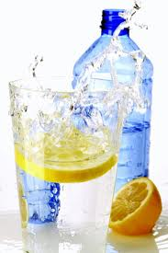
Drinks
Alcoholic:
Wine………. 30CZK
Beer………. 25CZK
Martiny………. 45CZK
Fernet………. 20CZK
Becher………. 50CZK
Soft Drinks:
Fanta………. 20CZK
Coca Cola………. 25CZK
Sprite………. 19CZK
Seven up………. 19CZK
Coca Cola light………. 26CZK

Slide 9
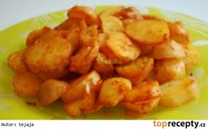
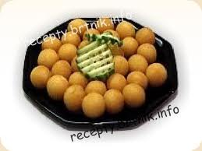
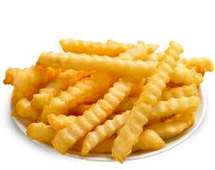
Sidedish:
Vegetable ………. 18CZK
Pasta………. 25CZK
Croquettes………. 30CZK
Chips………. 26CZK
Potato Dumplings………. 15CZK

Slide 10
Interview:
W: Good afternoon sir.
C:Good afternoon.
W: What would you like?
C: I would like a menu.
W: Of course, here you are sir.
C: Thank you. Five minutes later.
W: Have you chosen?
C: Yes. I'll have chicken with chips and for a drink Fanta .
W: Certainly sir right away.
C: Thank you.
After meal.
C: I would like to pay .
W: Sure, I'll be right with you sir.
C: How much is it?
W: So, we have Fanta and chicken with fries. So 20 dolars sir.
C: 22 dolars . Change for you.
W: Thank you very much sir.
C: Thank you , it was delicious. Good bye.
W: Thank you sir.Good bye.

Slide 11
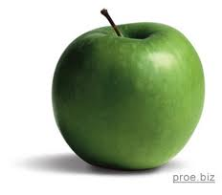
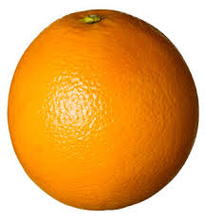
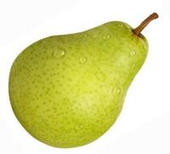
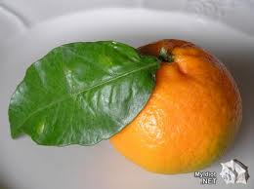
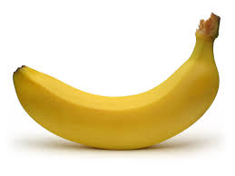
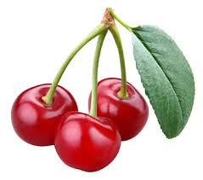
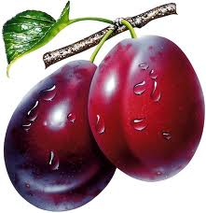
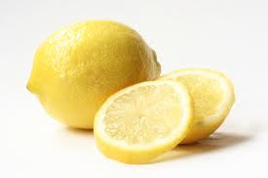
Pear
Lemon
Plum
Mandarin
Orange
Apple
Cherry
Banana

Slide 12
Vytvořil: Michal Hromádko
Zdroje: www.google.cz
www.wikipedia.cz
Děkuji za pozornost!
Have good meal!☺

