Slide 1
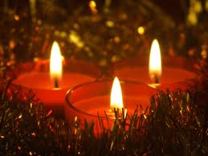

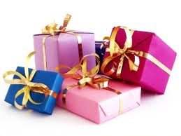
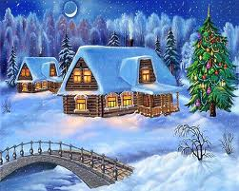
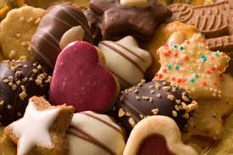
Christmas
http://www.youtube.com/we wish you

Slide 2
Doplňovačka
Dárek _ _ _ _ _ _ _
Stromeček _ _ _ _
Hvězda _ _ _ _
Svíčka _ _ _ _ _ _
Sníh _ _ _ _
Jmelí _ _ _ _ _ _ _ _ _
Krekry _ _ _ _ _ _ _ _
Punčochy _ _ _ _ _ _ _ _ _

Slide 3
Key
Present
Tree
Star
Candle
Snow
Mistletoe
Crackers
Stockings

Slide 4
Otázky
When do you celebrate Christmas?
Do you decorate a Christmas tree?
When do you get the presents?
What do you eat for Christmas dinner?
Who brings the presents,according to the tradition?

Slide 5
End
Merry Christmas and Happy New Year

